Slide 1
STUDENT NAME : S.HARINI COLLEGE NAME : PANIMALAR INSTITUTE OF TECHNOLOGY DEGREE : B.TECH BRANCH : ARTIFICIAL INTELLIGENCE AND DATA SCIENCE EMAIL-ID : harinisivanesan22@gmail.com NAANMUDHLAVAN ID : au211521243062
Final project

Slide 2
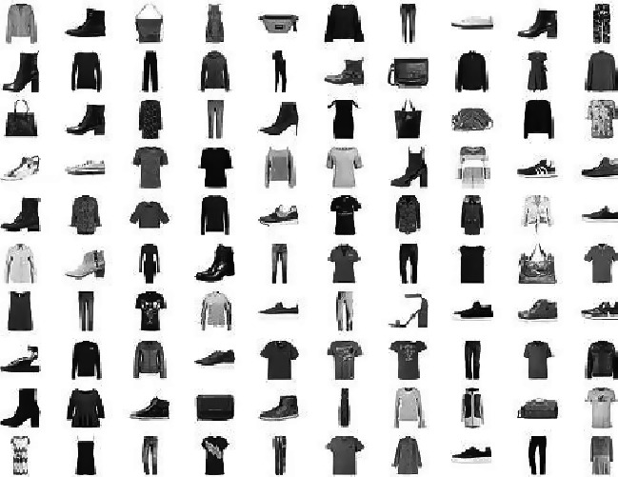
PROJECT TITLE
Fashion MNIST dataset using GANs

Slide 3
AGENDA
PROBLEM STATEMENT
PROJECT OVERVIEW
WHO ARE THE END USERS?
YOUR SOLUTION AND ITS VALUE PROPOSITION
THE WOW IN YOUR SOLUTION
MODELLING
RESULTS

Slide 4

PROBLEM STATEMENT
The Fashion MNIST dataset contains grayscale images of clothing items . Generative Adversarial Networks(GANs) are being exploded for fashion image generation. The challenge is to develop a GAN model capable of producing realistic ,indistinguishable fashion images, overcoming mode collapse and ensuring diversity

Slide 5

PROJECT OVERVIEW
Through its application to the fashion MNIST dataset, Generative Adversarial Networks(GANs) are intended to be introduced in this study. The 28*28 grey scale images of apparel items in 10 classes make up the Fashion MNIST dataset. The project will involve implementing a Gan architecture including a generator and discriminator to generat synthetic fashion images that closely resembles the ones in the dataset

Slide 6

WHO ARE THE END USERS?
Students and researchers
Data scientist and machine learning practitioners
Fashion industry professionals
Educators and instructors
AI enthusiasts and hobbyists

Slide 7

YOUR SOLUTION AND ITS VALUE PROPOSITION
Realistic fashion image production can be greatly improved by adding a Deep Convolution GAN(DCGAN) to the fashion MNIST dataset. The DCGAN architecture with its convolutional layers is well-suited for capturing spatial dependencies in images, ensuring that the generated fashion items exhibit realistic textures and patterns. By training the DCGAN on the fashion MNIST dataset we can generate high quality synthetic fashion images closely resemble real-world items.
With their capacity to produce realistic and varied fashion goods, these artificial images have the potential to revolutionize the fashion sector for a variety of applications, including data augmentation, virtual try-on solutions, and trend predictions.

Slide 8
THE WOW IN YOUR SOLUTION
By adding the deep convolution, the output data is variation is improved and the model is kept from becoming stale on a particular kind of image. What makes GANs so fascinating appears to be that the generator can produce meaningful images from the noise inputs without ever being able to see the real images.

Slide 9
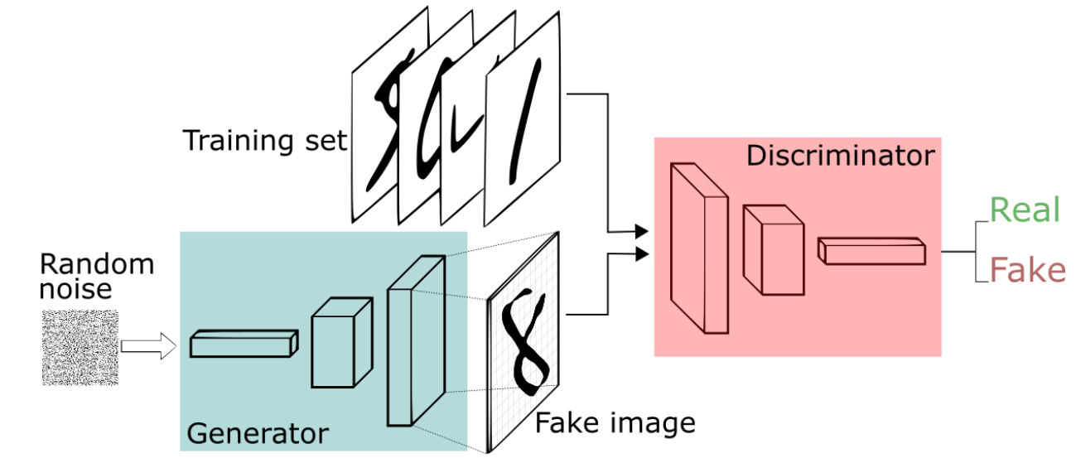
MODELLING
The model used in this project is DCGANs (Deep Convolution Generative Adversarial Networks)

Slide 10
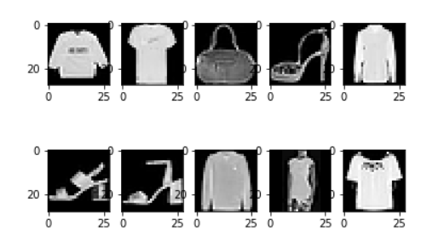
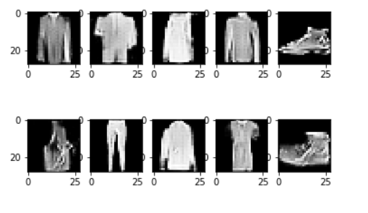
RESULTS
DCGANs generated images form noise
Original images

